Slide 1



PROJECT title grouP No-
Nilesh Gond (Roll No. 23)
Aman Gupta (Roll No. 25)
Chanchal Gupta (Roll No. 26)
Hridyansh Gupta (Roll No. 27)
Nidhi Gupta (Roll No. 28)
EMPLOYABILITY SKILL DEVELOPMENT PROGRAMM

Slide 2


Flow of Presentation
Introduction
Problem Statement
Description
Implementation
Discussion
Conclusion
EMPLOYABILITY SKILL DEVELOPMENT PROGRAMM

Slide 3
Introduction
Counselling is the process that includes different types of activities such as guiding students towards colleges and universities, supporting them mentally, providing full guidance in getting the information related to their education process as well as mental health.
In order to improve the services related to counselling process, we came up with online personal counselling application which will support people in getting the required help about the educational, mental counselling.
EMPLOYABILITY SKILL DEVELOPMENT PROGRAMM

Slide 4
Problem Statement
To develop an application for Online Personal Counselling.
The application will cater to people living in rural areas where a counsellor isn't present. Additionally it will also help extremely busy adults.
The user and counsellor both have register on the application. The credentials of the counsellor will be checked thoroughly.
The application will connect the users to the counsellors via chat or skype.
EMPLOYABILITY SKILL DEVELOPMENT PROGRAMM

Slide 5
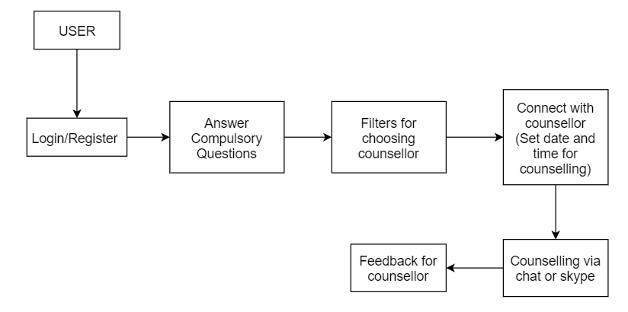
description
EMPLOYABILITY SKILL DEVELOPMENT PROGRAMM

Slide 6
implementation
Software Used:
Xampp
Sublime text editor
Programming Languages:
PHP
CSS
Javascript
HTML
EMPLOYABILITY SKILL DEVELOPMENT PROGRAMM

Slide 7
Gui
EMPLOYABILITY SKILL DEVELOPMENT PROGRAMM

Slide 8
contd...
EMPLOYABILITY SKILL DEVELOPMENT PROGRAMM

Slide 9
Conclusion
Online counseling has been shown to be effective for clients who may have difficulty reaching appointments during normal business hours,while decreasing the number of missed appointments for in-person therapy.
Our application will help individuals residing in rural or remote areas where there is no counselling services so they can benefit from the accessibility of online counselling. Those that are physically disabled or unable to leave their home can also easily access such services with little inconvenience.
EMPLOYABILITY SKILL DEVELOPMENT PROGRAMM

